Slide 1

Akrivia Health / Global Minds Proteomics Update
Julie Segueni, PhD, Bioinformatics
Kevin Blighe, PhD, Bioinformatics
Corey Oravetz, CSM, Project Manager​
Shahraz Niwaz, MSc , Business Account Manager
2026-Apr-14

Slide 2
Agenda
Action Items
Bio Updates
Open Q&A / Discussion
Timeline / Gantt
Month 2026
00

Slide 3
Meeting Minutes & Action Items

Slide 4
Meeting Minutes
Action Item Review
Joe: Prior analysis from Kris Rhodes remains open as he hadn't heard back from him yet. Joe: Will revisit the contact list to potentially find additional leads
Julie: Shared a slide deck from Paul Donovan covering the Akrivia dataset work done 3 years ago with Kevin.
Julie: Asked about exporting some of the clinical datasets with Patient Ids for the future correlation analysis.
Farzad: Confirmed access to the clinical data platform and had reviewed datasets with Lisa and Nasser, but has not yet attempted any export or analysis.
Joe: Suggested a meeting later in th week to do a small trial export to test feasibility.
Joe: Uploaded new NULISA immunology and CNS panel data to the Domino workspace and indicated the potential to do a similar analysis with this data.
Updates
Julie: Shared her limma OvR analysis on the neuropsychiatric dataset (dementia patients removed) found ~599 downregulated proteins only in depressive disorder. The bipolar, psychotic, and schizophrenic disorders yielded no differentially abundant proteins.
Julie: Re-did pathway analysis across all four diseases and identified disease-specific enriched pathways despite limited DA proteins
Joe: Asked about increasing patient numbers and if this would likely reduce adjusted p-values and surface more driver proteins.
Julie: Shared that this would likely reduce the adjusted p-values and would help identify more driver proteins respectively to the threshold, but it's likely the same core pathways would remain consistent across different analytical slices of the dataset.

Slide 5
Meeting Minutes
Updates (cont.)
Ricardo: Suggested pooling overlapping genes across schizophrenia, psychotic disorder, and bipolar disorder as an exploratory approach to improve statistical power and better define shared pathway connections.
Julie: Agreed and would explore this further
Ricardo: Suggested SynGO as a complementary, neuro-focused pathway database to supplement the GSEA analysis and potential surface additional synaptic density and provide more of a hint on what is happening.
Julie: Agreed to running the same analyses on the NULISA dataset was agreed upon as the next analytical priority, with the expectation that its more targeted protein list may yield cleaner results despite smaller feature space.
Julie: Proposed building a diagnostic prediction model using proteomic features to classify patients by disease, with Hydra identified as a candidate method for subtype discovery. She will check if this is usable without a control group.
Farzad: Highlighted the work of Chris Whelan and his work on plasma proteomic profiles.
Kevin: Confirmed he was one of the authors of the paper and noted this study on MDD used UK Biobank data internally at J&J. But, it had only made it through internal review and was decided not to publish the paper.
Erin: Suggested cross-referencing those MDD clusters with the current dataset.
Group: Confirmed the meetings on April 21st and 28th will be cancelled due to Julie's upcoming holidays and the team will reconvene on May 5th to allow time for Julie to work on the NULISA and for clinical data to come in.
Note: Julie OOO Apr 17-24th

Slide 6
Action Items
Action Items from 2026-Apr-14 Meeting
Joe: Potentially go back to Kevin's list and reach out to other contacts to track down the prior analysis. - IN PROGRESS
Joe/Farzad: Test a small group export of clinical data to verify the export process works. - IN PROGRESS
Julie: To try the SynGO pathway analysis on the dataset. - IN PROGRESS
Corey: Cancel the meetings on April 21st and April 28th. - COMPLETED, 2026-Apr-16
Julie: Send the list of Somalogic proteins to Ricardo to review. - IN PROGRESS
Julie: Start on the first prediction model for highlighting the the key features then move to the NULISA analysis. - IN PROGRESS

Slide 7
Action Items
Action Items from 2026-Mar-31 Meeting
Joe: Follow up with Kris Rhodes about prior analysis files. - IN PROGRESS
Julie: Review and identify common overlapping signatures and pathways between diseases. - IN PROGRESS
Julie: Complete upset diagram plot showing common DA proteins across diseases. - IN PROGRESS
Julie: Perform analysis removing dementia and focusing on the four neuropsychiatric disorders. - IN PROGRESS
Farzad: Discuss plan for clinical data analysis. - IN PROGRESS
Joe: Presentation of dataset and analysis plan (NULISA) - TODO
Julie: Start analysis of new dataset and compare Somalogic dataset to NULISA dataset - IN PROGRESS
Action Items from 2026-Mar-17 Meeting
Joe: Circle back and confirm that sharing subject IDs from the Akrivia database without other associated data is approved by the broader group. - IN PROGRESS
Julie: Provide a more direct comparison of the effect of age adjustment on the pathways. - IN PROGRESS
Action Items from 2026-Feb-10 Meeting
Joe: Provide Julie with any details about the normalization process that was applied to one of the data files - IN PROGRESS
Joe: Check on the progress of clinical data analysis and share any relevant co-morbidities or self-reported information that might be useful for differential analysis in next week's meeting – IN PROGRESS
Note: Julie OOO Apr 17-24th

Slide 8
Bio Updates

Slide 9
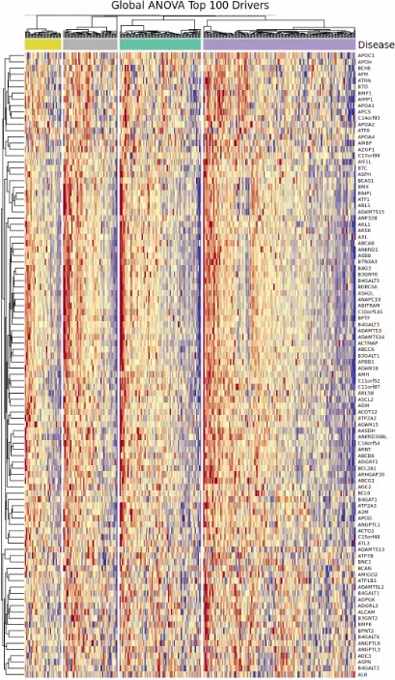
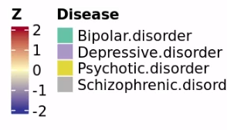
Design change
Removed the 124 Dementia patients from the analysis to focus on neuropsychiatric disorders
Reproduced the ANOVA analysis from Paul to see top 100 driver proteins
No major patterns only subtle differences even using z-score instead of raw abundances

Slide 10
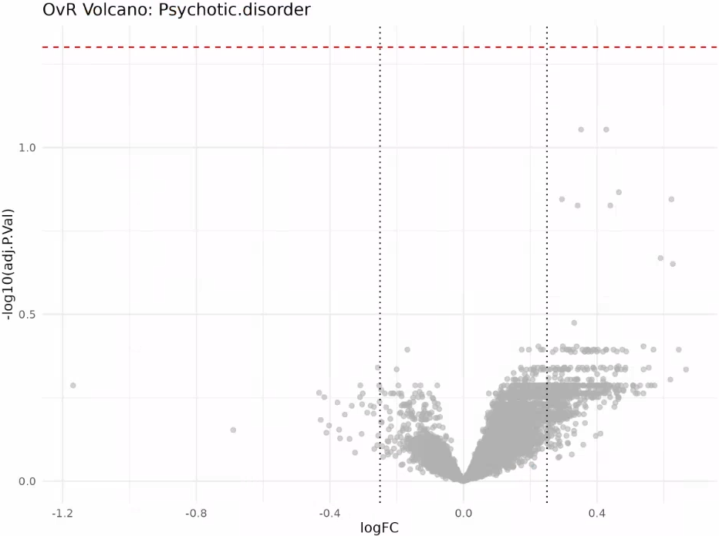
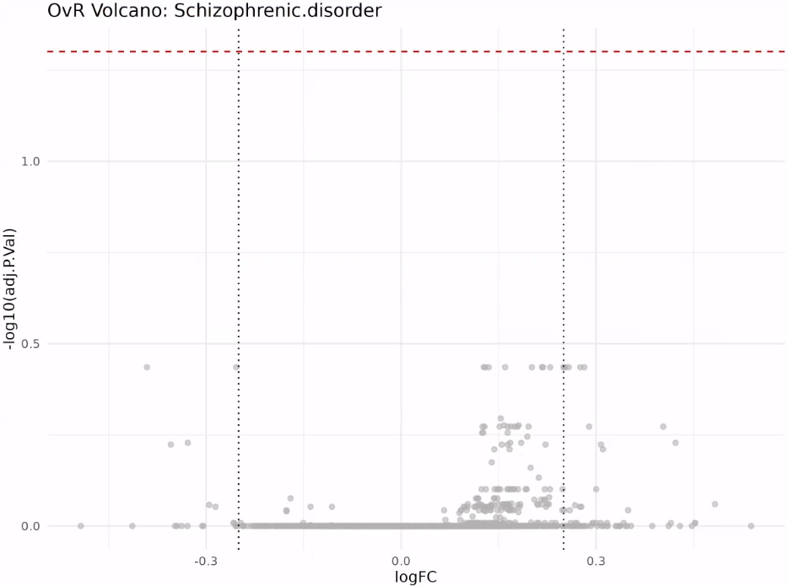
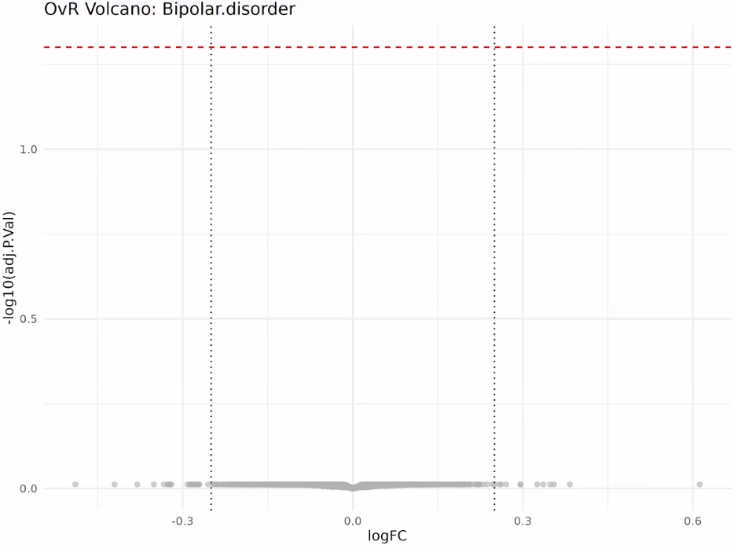
DA analysis in 4 diseases only
Re-analyzed the limma OvR analysis using the new design
Found no DA proteins for Bipolar disorder, Psychotic disorder, or Schizophrenic disorder
Found 599 downregulated DA proteins in Depressive disorder

Slide 11
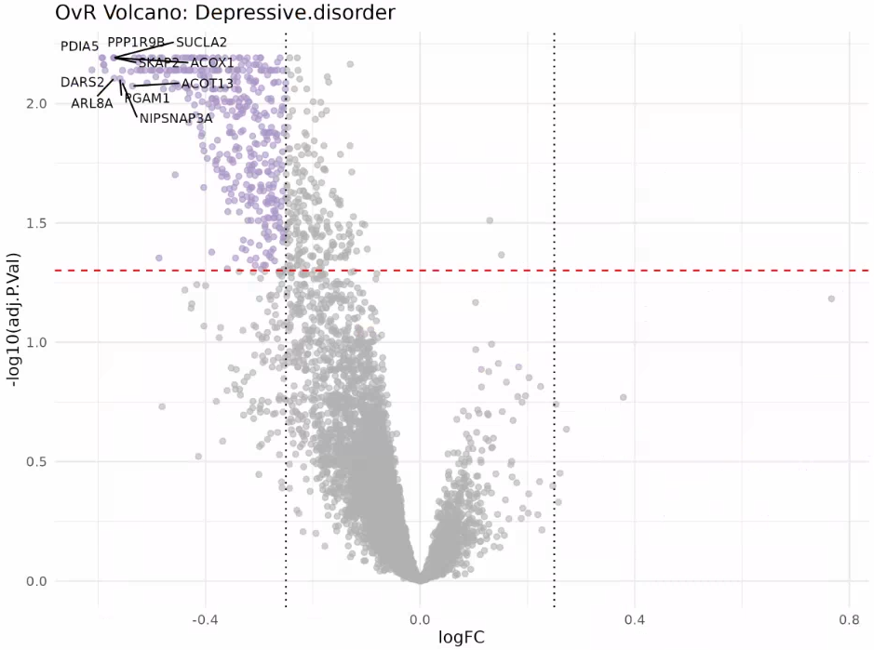
DA analysis - OvR Volcano: Depressive Disorder
OvR Volcano: Depressive disorder
Genes
PDIA5
PPP1R9B
SUCLA2
SKAP2
ACOX1
DARS2
ACOT13
ARL8A
PGAM1
NIPSNAP3A

Slide 12
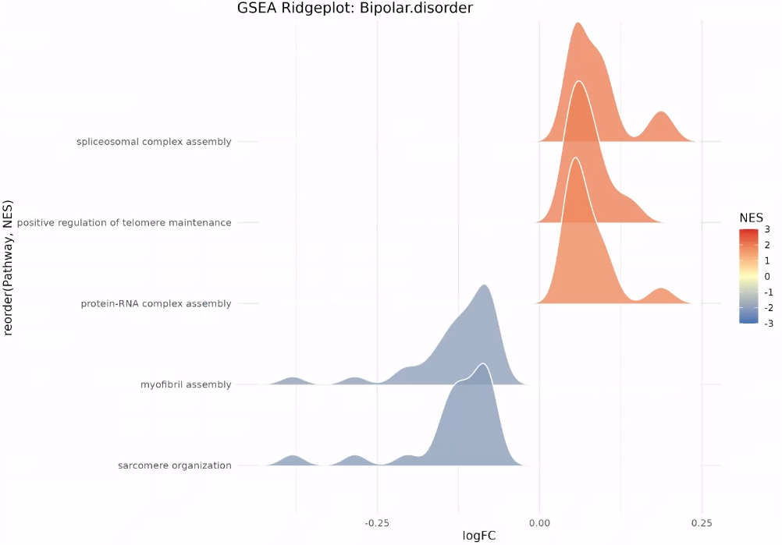
Pathway analysis in 4 diseases only
Redid the pathway analysis using the limma OvR results (also including non-DA proteins)
Bipolar disorder patients have upregulated spliceosomal complex assembly, positive regulation of telomere maintenance and protein-RNA complex assembly.
Bipolar disorder patients have downregulated myofibril assembly and sarcomere organization

Slide 13
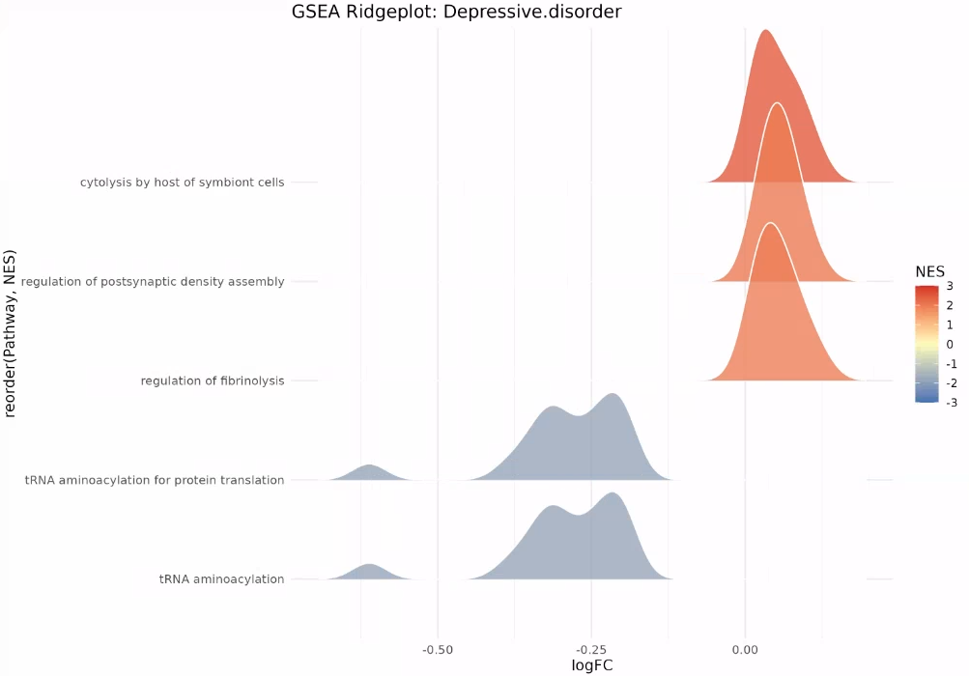
Pathway analysis in 4 diseases only
Redid the pathway analysis using the limma OvR results (also including non-DA proteins)
Depressive disorder patients have upregulated cytolysis by host of symbiont cells, regulation of postsynaptic density assembly and regulation of fibrinolysis.
Depressive disorder patients have downregulated tRNA aminoacylation for protein translation and tRNA aminoacylation

Slide 14
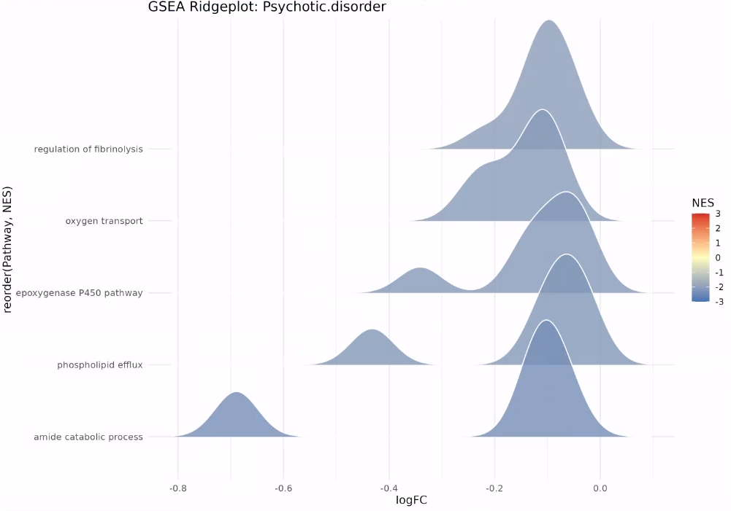
Pathway analysis in 4 diseases only
Redid the pathway analysis using the limma OvR results (also including non-DA proteins)
Psychotic disorder patients have downregulated regulation of fibrinolysis, oxygen transport, epoxygenase P450 pathway, phospholipid efflux, amide catabolic process.

Slide 15
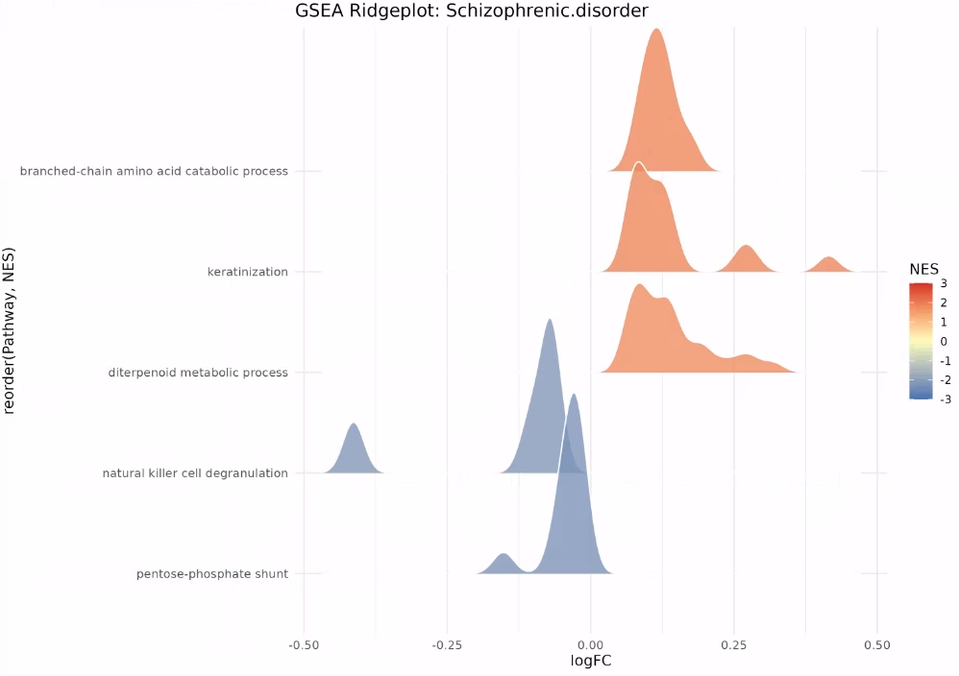
Pathway analysis in 4 diseases only
Redid the pathway analysis using the limma OvR results (also including non-DA proteins)
Schizophrenic disorder patients have downregulated diterpenoid metabolic process, natural killer cell degranulation, pentose phosphate shunt

Slide 16
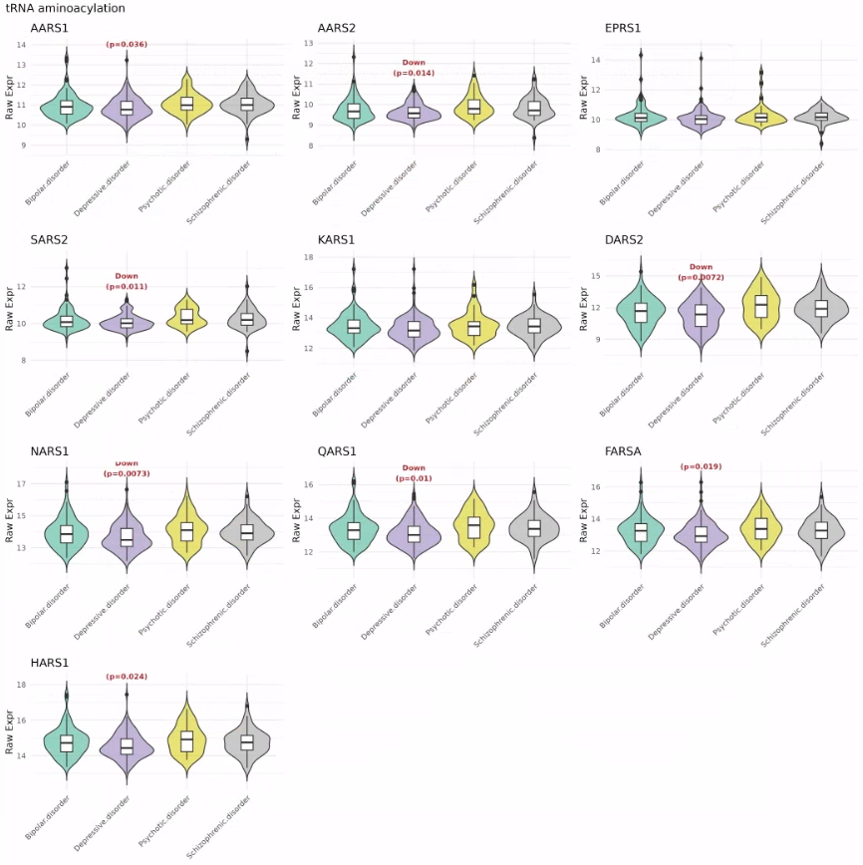
Pathway analysis in 4 diseases only – Focusing on tRNA aminoacylation
Redid the pathway analysis using the limma OvR results (also including non-DA proteins)

Slide 17
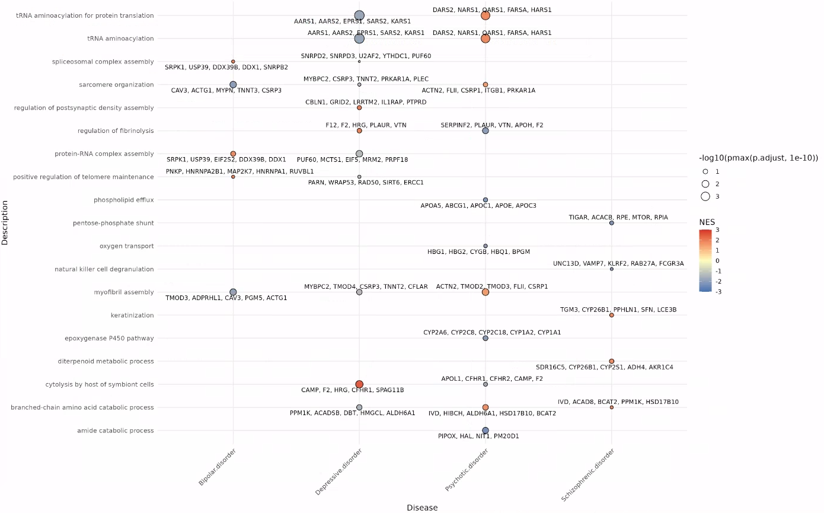
Pathway analysis in 4 diseases only
Redid the pathway analysis using the limma OvR results (also including non-DA proteins)

Slide 18
Timeline & Deliverables

Slide 19
J&J: Akrivia Health SomaLogic Proteomics Analysis
Timeline
Today
2026
Feb
Mar
Apr
Feb 3 - Feb 9
5 days
Onboarding, Environment Setup, Data Import into Domino
2026
Feb 10 - Feb 13
4 days
Data Normalization & QC
Feb 16 - Feb 23
6 days
Diff Abundance Analysis (DAA)
Global Minds / Akrivia Proteomics Analysis
Feb 24 - Mar 30
Pathway Analysis + Variance Partitioning Analysis + Rework
25 days
Mar 31 - Apr 13
Compare Treatment-Resistant Patients vs Responders
10 days
Correlate Proteomics Levels to Clinical Data
10 days
Apr 14 - Apr 27
Apr 28 - Apr 29
Reporting & QC
2 days
Timeline
On-Boarding (4 hours)
Data Retrieval, Normalization, & QC (16 hours)
Differential Abundance Analysis (DAA) (24 hours)
Pathway Analysis (24 hours)
Compare treatment-resistant patients vs responders (16 hours)
Correlate proteomics levels to clinical data (12 hours)
Reporting & QC (8 hours)
Total: 104 hours Bioinformatics; 10 hours Project Management.
Timeline approved for NULISA dataset? Extend analysis while waiting for Clinical Data?
Pause additional comparisons/correlations until Akrivia Clinical Data is available?
Pause additional comparisons/correlations until Akrivia Clinical Data is available?

Slide 20
Archive

Slide 21
Action Items
Action Items from 2026-Mar-17 Meeting
Julie: Ask Kevin about age correction in the previous analysis and obtain the relevant slides - Julie: Create protein abundance heat maps for proteins within enriched pathways from the rich plots. - COMPLETED (NO ACCESS TO FILES OR CODE)
Julie: Create a heat map showing average protein expression per diagnosis (bipolar disorder, dementia, depressive disorder, psychotic disorder) for the DA proteins. - COMPLETED
Action Items from 2026-Mar-10 Meeting
Julie: Extract proteins within the ridge plot peaks and plot them on raw abundance heatmaps. - COMPLETED

Slide 22
Action Items
Action Items from 2026-Mar-10 Meeting
Julie: Redo DA analysis and Pathway analysis using Age as covariate – COMPLETED, 2026-Mar-17
Julie: Color the volcano plot by identified pathway membership to show distribution of effect sizes per pathway. - COMPLETED, 2026-Mar-17
Julie: Provide new plots showing raw pathway-level abundances using dementia as a reference group across all diseases. - COMPLETED, 2026-Mar-17
Joe: Check-in with Alessandra that the budget and spend are acceptable if the project timeline extends. - COMPLETED, 2026-Mar-17
Action Items from 2026-Feb-24 Meeting
Julie: Pathway analysis from DAA results – COMPLETED, 2026-Mar-09
Action Items from 2026-Mar-17 Meeting
Julie: Julie to consider further analysis during the DAA that can statistically validate the absence of bias effects - COMPLETED, 2026-Mar-17
Julie: Start on the DAA process – COMPLETED, 2026-Feb-23
Action Items from 2026-Feb-10 Meeting
Joe: Joe to reach out to Akrivia to get clarification about the 17 samples labeled as 'other' - COMPLETED, 2026-Mar-17
Julie: Start on the QC and normalization process – COMPLETED, 2026-Feb-13

Slide 23
Action Items
Action Items from 2026-Feb-03 Meeting
Joe: Provide access to the MS Teams folder with the clinical XLS files – COMPLETED, 2026-Feb-06
Farzad: Create a new Domino project and upload the proteomics data files for the analysis – COMPLETED, 2026-Feb-03
Corey: Setup weekly calendar cadence for the team to meet – COMPLETE, 2026-Feb-03

